Slide 1
Lab 3 Data path of Single Cycle CPU
柏宏

Slide 2
Notice
Lab 3 is group work
Please follow Group ID in cloud (https://reurl.cc/nzN58n)
We recommend you to find teammate
Lab 3 will have individual Demo (remote?)
Run your program in your computer
Run special test case in your computer (considering)
Code review
Ask questions
All of you need to submit to new e3, format: “GroupID_ID1_ID2.zip”
Deadline 2020/05/14
Notes:
https://docs.google.com/spreadsheets/d/1ZUCVMoT-TsYwq-XjuQmA8R_mjxXebLykivcohCnJsTE/edit?usp=sharing

Slide 3
If you have any problems about the specification,
Please contact TA as soon as possible
Contact:
鄭俊賢 petertay1996.cs08g@nctu.edu.tw
Notes:
https://docs.google.com/spreadsheets/d/1ZUCVMoT-TsYwq-XjuQmA8R_mjxXebLykivcohCnJsTE/edit?usp=sharing

Slide 4
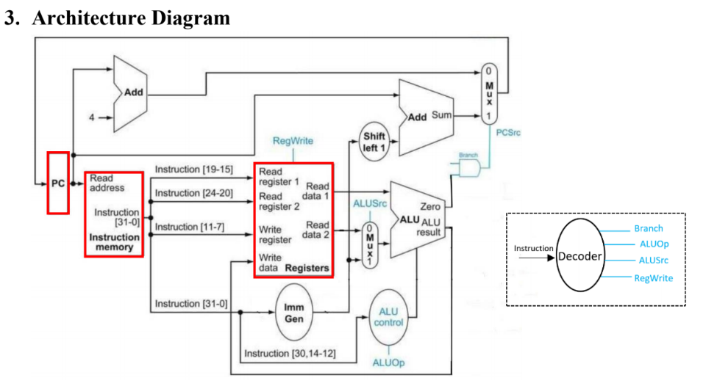
Overview of lab 3
Implement Datapath of Single Cycle CPU as below
Provided
Notes:
https://docs.google.com/spreadsheets/d/1ZUCVMoT-TsYwq-XjuQmA8R_mjxXebLykivcohCnJsTE/edit?usp=sharing

Slide 5
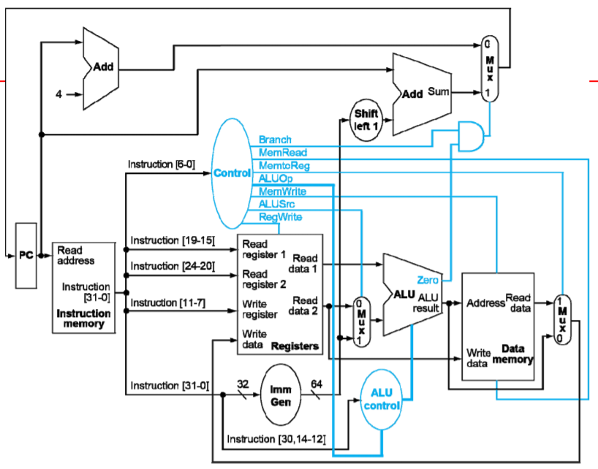
Follow last page’s diagram
There is no data memory in lab 3

Slide 6
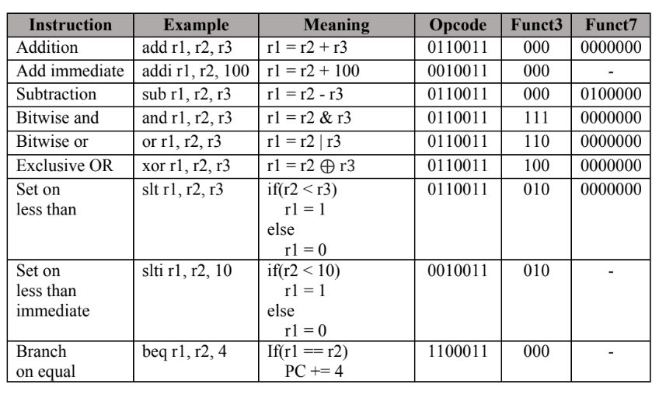
Basic Instruction set of lab3 (60%)
Notes:
https://

Slide 7
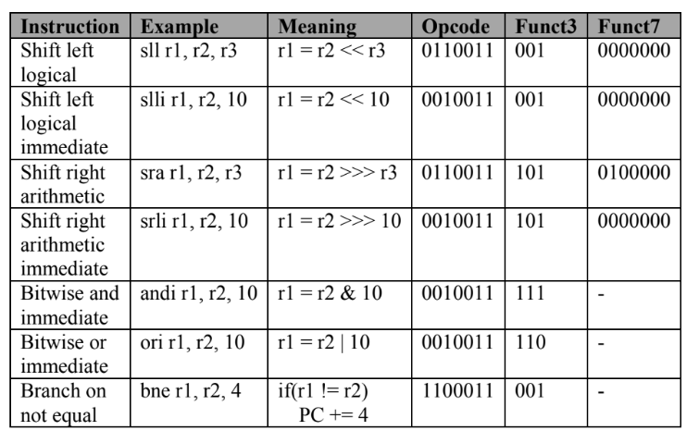
Advanced Instruction set of lab3 (20%)
Notes:
https://

Slide 8
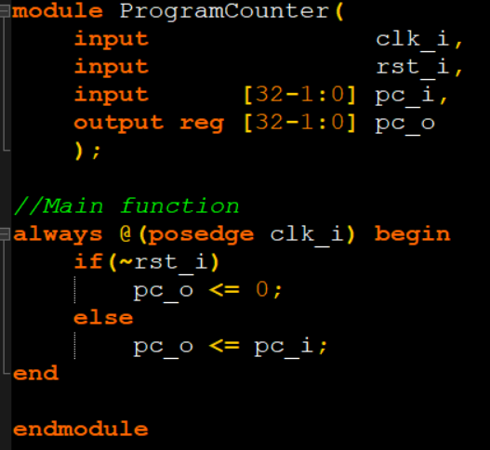
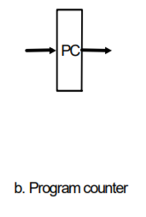
PC (TA offer)
Register use to store Program Counter value

Slide 9
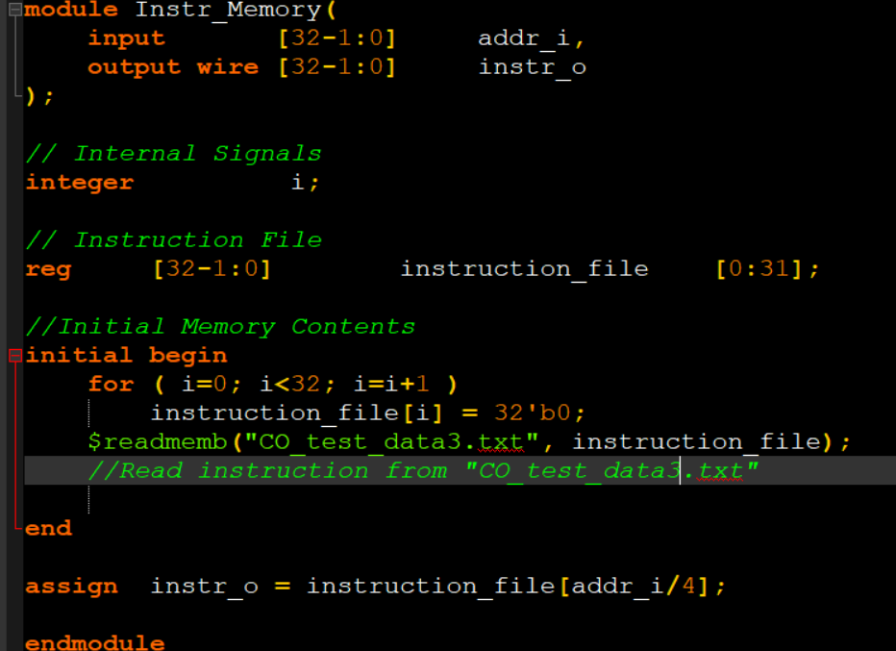
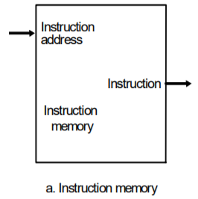
Instruction memory (TA offer)
Fetch instruction by using PC value

Slide 10
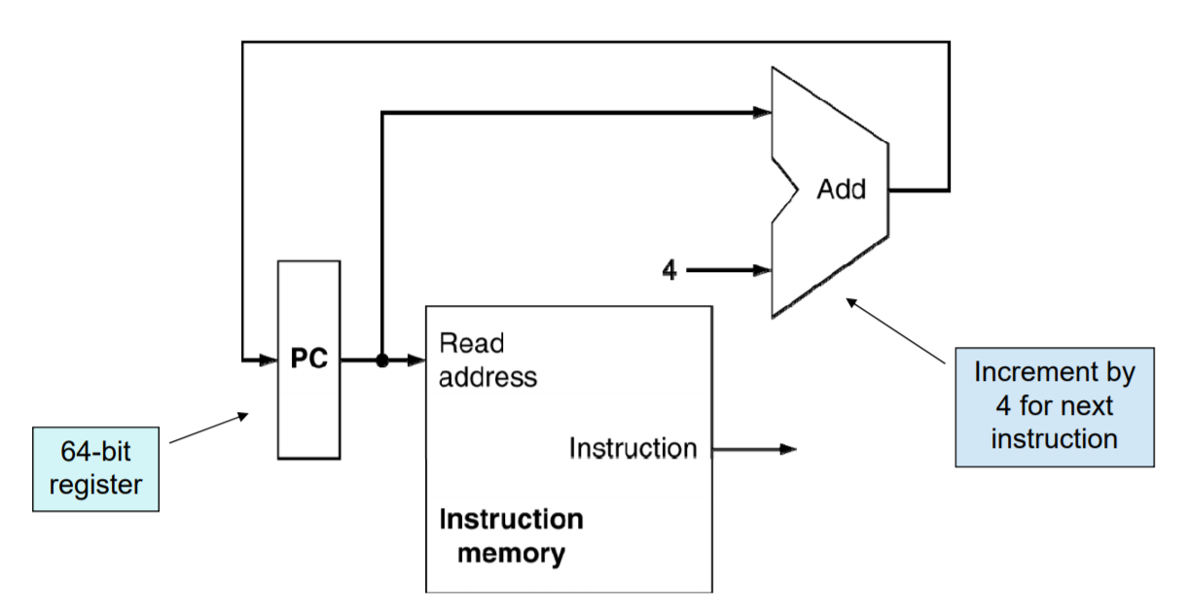
Instruction fetch

Slide 11
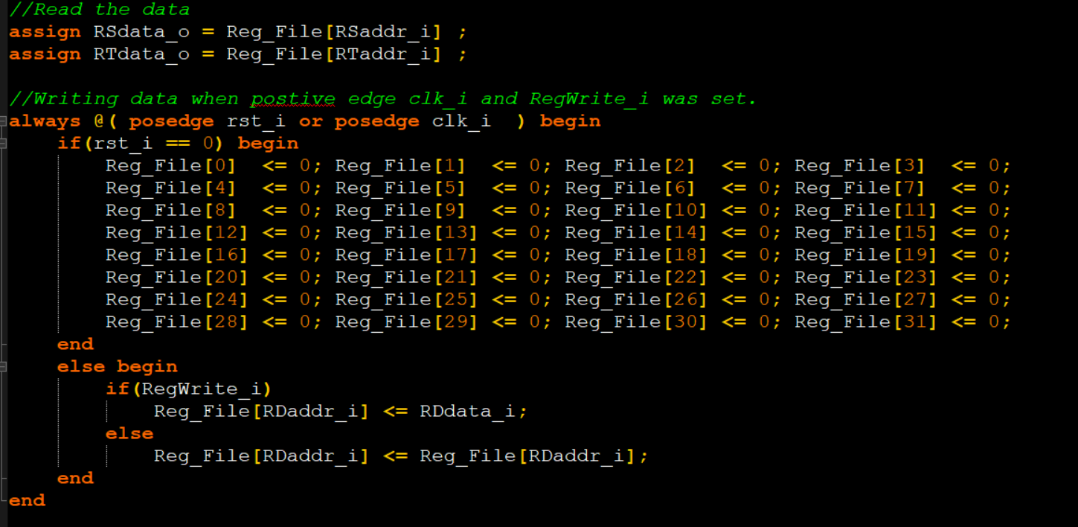
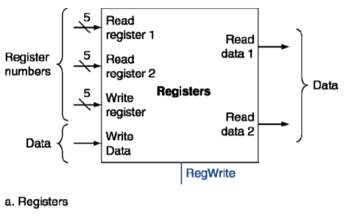

Register file(TA offer)

Slide 12
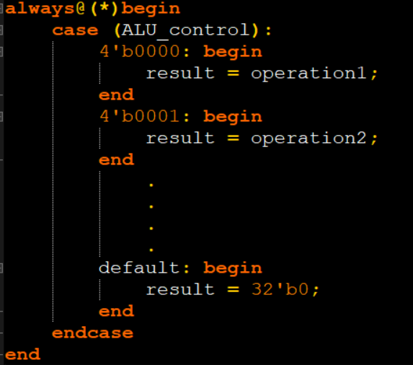
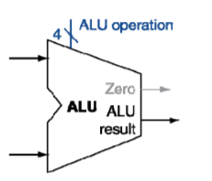
ALU
Extend ALU op design to support more instructions
You don’t need to bottom up build ALU form “ALU 1bit”
For instance:
same

Slide 13
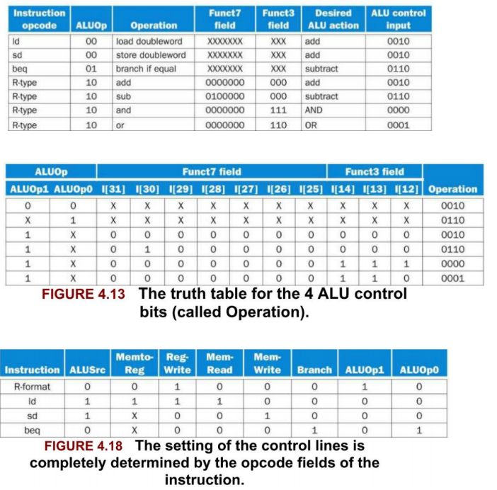
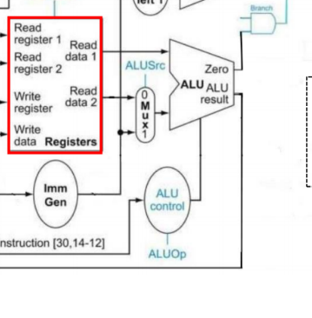
ALU_operation (ALU_control)
Value of ALU_operation (ALU_control) is assigned by “ALU_control”
More specific please follow
ALU_control unit

Slide 14
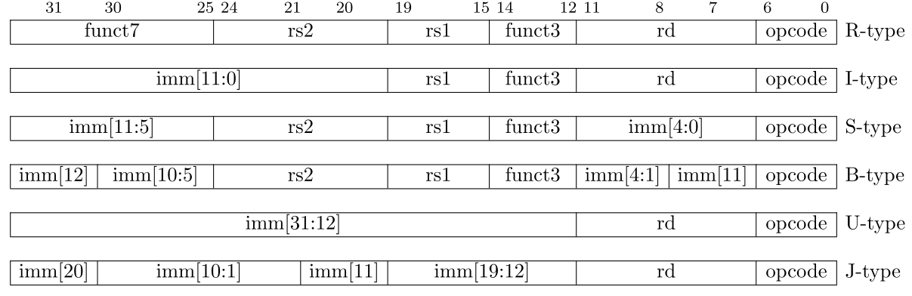
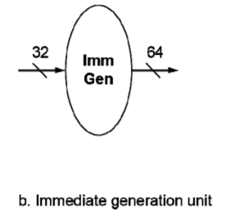
Immgen
Use both opcode and funct3 to determine Immgen
32

Slide 15
Top Module
File :Simple_Single_CPU.v
Please connect wire and modules to Simple_Single_CPU.v
Remember to implement “and operation” for PCsrc

Slide 16
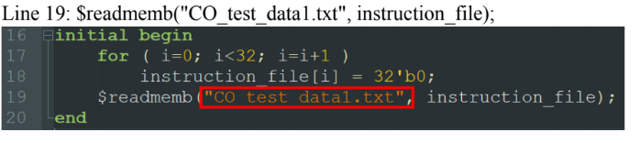
Testbench
3 test cases (CO_test_data1.txt ~ CO_test_data3.txt.)
Need to manual change by yourself
Edit line 19 in the file “Instr_Memory.v”
Notes:
https://

Slide 17
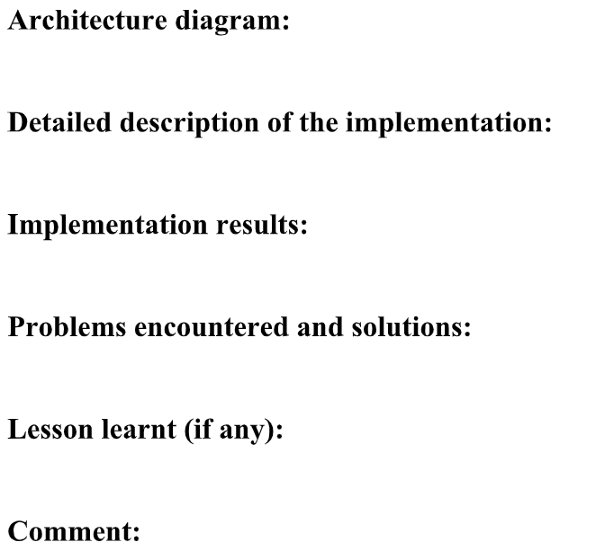
Report format
Can combine
Notes:
https://

